Slide 1
New Orleans Homelessness Crisis:
A Multi-Faceted Approach
Team #63

Slide 2
NOLA Point-In-Time Count
January 3, 2023
Total Homeless Population: 1,390
40%
38%
65%
Of the homeless population was unsheltered
Of the homeless population have no high school diploma or GED
Of the homeless population was Black
White: 33%; Latino: 5%
Latino homelessness has increased by 248%
PROGRESS REVERSED: After Pandemic Initiatives Drive Homelessness Down, Soaring Rents Push Numbers Back Up. Unity of Greater New Orleans. (n.d.) https://unitygno.org/wp-content/uploads/2023/09/2023_UNITY_PIT_Report.pdf
Notes:
The Point in Time Count is an annual survey of people facing homelessness in the United States, conducted by local agencies called Continuums of Care on behalf of the US Department of Housing and Urban Development. The New Orleans Continuum of Care is UNITY of Greater New Orleans, a collaborative of 63 organizations that provide housing and services to those experiencing homelessness in New Orleans and Jefferson Parish.

Slide 3
Assessing the Problem
Pandemic Successes ¹
Rent & Insurance Rates ²
Barriers to Shelters ¹
Federal funds allowed New Orleans to house 1,000 people facing homelessness in hotel rooms.
80% remained permanently housed as of 2023.
Individuals accepted hotel rooms as they offered privacy without barriers.
The economic impact of COVID-19 caused a spike in post-pandemic rent prices.
Hurricane Ida resulted in a statewide housing insurance crisis.
Even for shelters with low barriers, many are short-staffed.
This leads to calls regarding space availability to go unanswered.
1. Chavez, R. (2023, July 14). “we’re barely making it.” why more New Orleans families are without stable housing. PBS. https://www.pbs.org/newshour/nation/were-barely-making-it-why-more-new-orleans-families-are-without-stable-housing#:~:text=The%20most%20recent%20Point%2Din,up%20from%201%2C042%20in%202021.
2. Schuppe, J. (2022, September 16). Louisiana faces an insurance crisis, leaving people afraid they can’t afford their homes. NBCNews.com. https://www.nbcnews.com/news/us-news/louisiana-homeowners-insurance-crisis-hurricanes-rcna46746
Notes:
To assess the problem, we are considering three factors.
Rent and Insurance Rates:
Following the pandemic, the grants were not renewed, causing hotel rooms to no longer be an option.
In 2020 and 2021, Louisiana was hit by four major hurricanes. The last of the four, Hurricane Ida destroyed thousands of homes and cost insurers almost $7 billion in claims paid to homeowners, on top of the $5 billion for the previous 3 storms. This caused many small insurance companies to go completely out of business.
Barriers to Shelters:
Some shelters require IDs, curfews, gender separation, religious devotion, removal of items or pets, etc. NOLA expanded its Low Barrier Shelter in 2021, and this shelter does not have these requirements but it does have other barriers that short-staffing contributes to.

Slide 4
Accessibility
Privacy
Homeless Shelter Availability Database
Private Housing Arrangements
Our solution incorporates elements from all three of these sectors, creating a multi-faceted approach to solving the homelessness crisis in New Orleans.
Employment Assistance
Autonomy
Notes:
Our three-pronged solution will tackle these three main tenets of the homelessness problem: accessibility, autonomy, and privacy. We will keep an up-to-date homeless shelter availability database which provides accurate contact information, shelter restrictions, and beds available. We will offer employment assistance programs within shelters to offer personalized solutions for each individual. We will renovate existing buildings into transitional and permanent housing that ensures privacy and freedom of residents.

Slide 5
01
Homeless Shelter Availability Database

Slide 6


“Each shelter has its own rules…they struggle with staffing. Calls to see if there’s space on any given day can go unanswered.”
- Nathaniel Fields, Director of NOLA Office of Homeless Services & Strategy ¹
Click here!
The phone number of the NOLA Low Barrier Shelter found online is invalid ²
1. Chavez, R. (2023, July 14). “we’re barely making it.” why more New Orleans families are without stable housing. PBS. https://www.pbs.org/newshour/nation/were-barely-making-it-why-more-new-orleans-families-are-without-stable-housing#:~:text=The%20most%20recent%20Point%2Din,up%20from%201%2C042%20in%202021.
2. “Community Development - Homeless Service Providers - City of New Orleans.” Nola.gov, 2023, nola.gov/community-development/homeless-service-providers/.
Notes:
Improving accessibility to existing resources is an essential part of our solution. As mentioned previously, there are serious barriers to shelter access, both in terms of capital and administrative inefficiencies. The current NOLA.gov website that provides homeless service providers has minimal information and no information about general or daily bed availability. Some information is even incorrect. The Low Barrier Shelter, the largest and most accessible homeless shelter in NOLA, does not have a working phone number on this website. When our group called the shelter, we were met with an out of service message (click play) which is extremely detrimental to homeless individuals and those who serve the population, including health care workers, community outreach workers, and social workers trying to connect with services.

Slide 7
Homeless Shelter Availability Database
Contact Information
Requirements for registration/enrollment
Services Provided
Hourly updating of Bed Availability
Live Database will be available on the websites of HousingNOLA, NOLA.gov, and Office of Homeless Services and Strategy.
Notes:
The database would entail up-to-date contact information, requirements for registration and enrollment (including restrictions on substance use, pets, religion), services provided (including financial responsibility classes, daytime activities, etc.) similar to the current NOLA website.
However, the unique mechanism would be an hourly updating of beds available in each shelter. This would be especially helpful for emergency room physicians and jails to have, so there are systems in place to avoid “patient dumping” of homeless individuals into the streets
The database would be linked to the already existing websites that offer contact information, or even a modification of already existing websites with the additional of a daily bed update. Though there is not an Office of Homeless Strategy and Services website yet, if there is one upcoming, we would add this to that website!

Slide 8
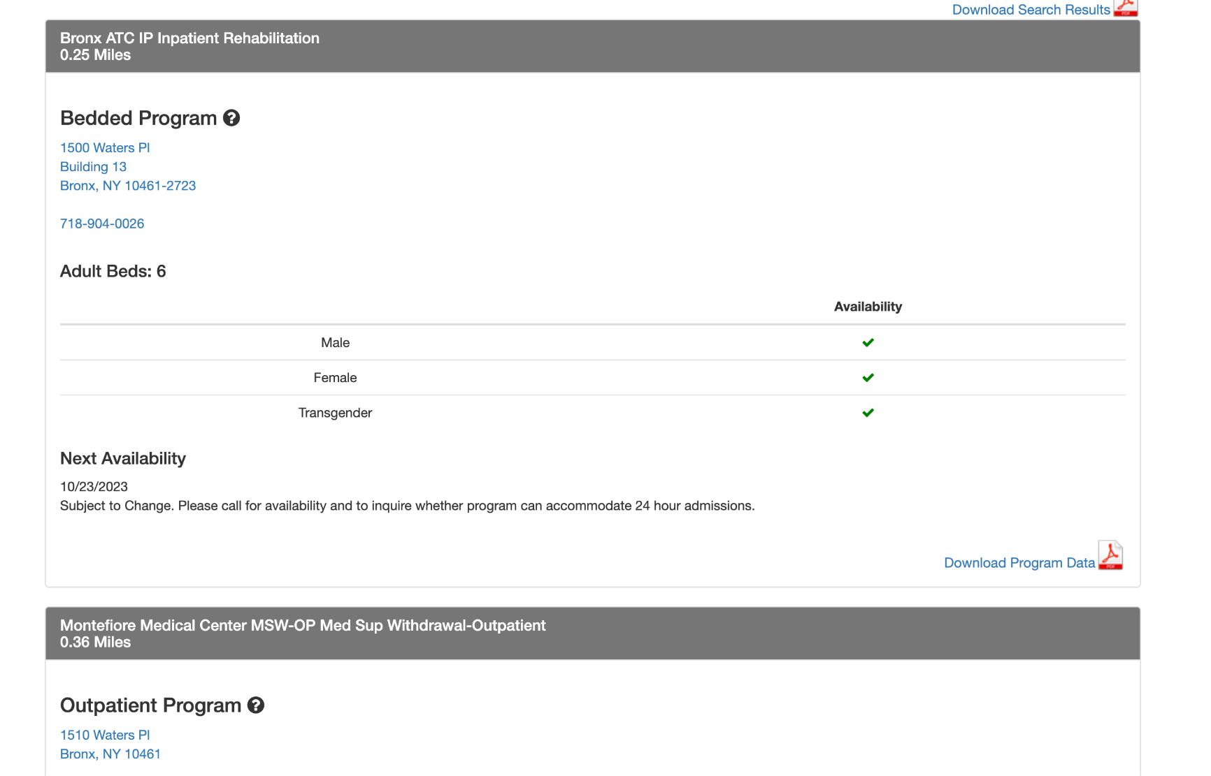
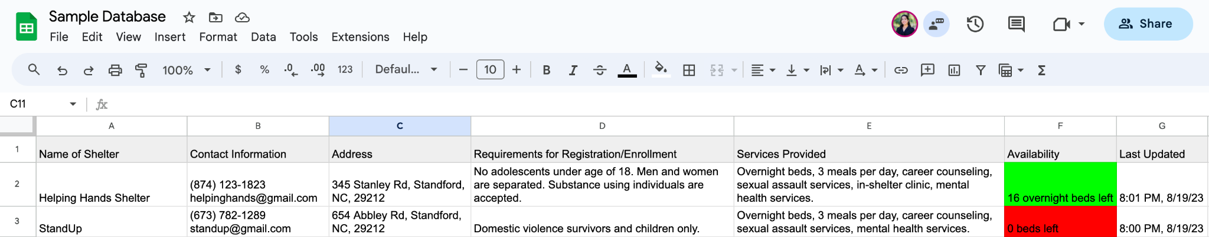
NY State’s “Find Addiction Treatment” Database
Sample Database on Google Sheets
1. OASAS Treatment Availability. (n.d.). Findaddictiontreatment.ny.gov. https://findaddictiontreatment.ny.gov
Notes:
Our central idea is to have a regular updating of number of beds. The New York State’s Find Addiction Treatment Database designated for substance use treatment represents a rough idea of what this would look like. As you can see on the NY website, it shows that for substance abuse inpatient rehab programs, there are daily availability updates on the number of beds. This database contains availability for specific demographics (like genders) and includes when more information will be next available.
Our database would be hourly rather than daily updates, because we anticipate bed availability to fluctuate more in these shelters. But this would not be every hour of everyday, but rather when they start accepting clients into the shelter to take a bed. Starting 5PM, for example, to when they run out of beds for the day.
A demo of our idea is constructed on Google Sheets, which is user-friendly for shelter staff to live update every hour from the start of their check-in time. If this database concept were to be integrated on the actual NOLA site, there would need to be a mechanism in place that allows shelter staff to easily live update information from the backend.

Slide 9



Benefits
Standardizes transparency → reduces discrepancies in information available
Tracks beds & reduces information inquiries from clients → decreases burden of short staffing¹
Allows ERs and jails² to offer a cumulative resource to at-risk peoples prior to discharge³
1. writer, B. M. | S. (2023, May 3). New Orleans area homelessness soars with rising rent, return of evictions. NOLA.com. https://www.nola.com/news/new-orleans-homelessness-surges-as-housing-costs-rise/article_5c5c7c52-e92c-11ed-b34b-2f406d317149.htm
2. The cost of homelessness: 10%, the chronically homeless, use 90% of resources. (2023, April 4). Port City Daily. https://portcitydaily.com/latest-news/2023/04/04/the-cost-of-homelessness-10-the-chronically-homeless-use-90-of-resources/
3. Caiola, S. (n.d.). California Hospitals Strive To Comply With New Homeless Patient Laws, But Say Lack Of Resources Makes It Tough. Www.capradio.org. Retrieved October 22, 2023, from https://www.capradio.org/articles/2019/01/21/california-hospitals-strive-to-comply-new-homeless-patient-laws-but-say-lack-of-resources-makes-it-tough/#:~:text=Physicians%20across%20the%20state%20ar
Notes:
This transparent, accessible database has many benefits.
First, keeping timely updates of bed availability would reduce phone calls of individuals asking about bed availability, requirements, etc., offering relief to short-staffed shelters. This is a major issue at the Low Barrier Shelter, one of the most accessible and largest shelters in New Orleans.
Second, it avoids discrepancies in available information. We showed you the phone call we made to the Low Barrier shelter. Though it is imperative that that phone number is fixed, this database would at least offer accessible information in spite of it.
Finally, the construction of a pathway for temporary housing from the ER and jail are locations that many people facing homelessness cycle through (source 2).
Our database especially aids in this last point when examining how certain mechanisms can fail in other states. In California, the state government has mandated hospitals to find homeless dischargees temporary shelter, but the administrative burden of managing this process can take hours (source 3). This process would be made more efficient if hospitals could just see how many beds were available; this database avoids patient dumping while still being efficient and easy to incorporate.

Slide 10
02
Employment Assistance
Notes:
We will offer employment assistance through the implementation of career coordinators.

Slide 11
Homelessness is not just about housing…
Hire 13 career coordinators, 1 placed at each New Orleans shelter
*Hired through the Office of Services and Strategy
Offer one-on-one sessions to match clients with tailored job opportunities
Help clients apply for health insurance and/or disability assistance
Keep a running catalog of internal and external job opportunities
Partner with Unity of Greater New Orleans’ Coordinated Entry System (CES) Managers
Host professional development classes in shelters
Notes:
We propose that the Office of Homeless Services and Strategy hire 13 career coordinators, 1 placed at each NOLA shelter.
So, what would career coordinators do?
They would offer individualized meetings with clients who enter emergency shelters (either for day shelter or overnight shelter) to create a tangible plan on how to get them out of their crisis through employment, health insurance applications, and disability assistance.
CCs would also keep a running catalog of jobs within the shelter, like construction, janitorial, food preparation/distribution jobs, and jobs outside of the shelter, like retail, fast food, and healthcare.
They would host or outsource to volunteer guest speakers professional development classes, like how to develop a resume, interview preparation, and increasing self-confidence.
This program would partner with the already existing Unity of Greater New Orleans’ Coordinated Entry System, or CES, managers. This coordinated entry system assesses a housing crisis and matches them to a variety of different programs, including HUD Emergency Solutions Grant-funded programs (ESG) which funds street outreach, emergency shelter, and other activities, and also HUD Continuum of Care-funded programs, and rapid rehousing (RRH) and Permanent Supportive Housing (PSH). Let me explain how this partnership works.

Slide 12
Partnership Among CES and CCs
Access the Coordinated Entry System at an Entry Point
Assessment through navigation meetings that get clients “document ready” for referral
Prioritization for referral to CoC or ESG-funded housing offered based on time, severity, and completion of required documentation
Matching & Referral to CoC/ESG housing, emergency shelters, transitional housing, permanent housing
If matched to emergency shelters, Career Coordinators offer employment or services support
Transitional Housing or Permanent Housing
Client’s Housing Crisis Resolved
UNITY of Greater New Orleans Continuum of Care (CoC) Housing & Service System: Coordinated Entry Policies and Procedures Handbook LA-503 New Orleans-Jefferson Parish-Kenner CoC. (n.d.). Retrieved October 28, 2023, from https://unitygno.org/wp-content/uploads/2022/08/LA-503-Coordinated-Entry-PP-Dec21.pdf
Notes:
Essentially, this results in the coordination of our novel idea and an already existing solution and makes it more effective!
This chart visualizes how a partnership between career coordinators under Office of Homeless Services and Strategy and Unity’s coordinated-entry-system managers would be organized. We used information from the Unity Continuum of Care Handbook for Coordinated Entries Policy and integrated our solution.
Clients would access the system by an entry point, like street outreach or emergency shelters, medical facilities, or release from jail. The CES managers would assess their need through weekly navigation meetings, and then prioritize matches to different housing based on certain factors.
Clients would be matched to housing. If matched to emergency shelters, CCs would offer employment or support.
We will discuss the next steps in this system in our next solution :)
*ESG = Emergency Solutions Grant, *CoC = Continuum of Care Grant

Slide 13
Benefits of Government Employed Career Coordinators
Disability Advocacy
91% of NOLA’s homeless population is disabled. ²
Approval rates for first-time applications for Supplemental Security Income (SSI) and Social Security Disability Insurance (SSDI) among adults who are homeless can be as low as 10%.
2010 Study: Impact of Assistance on SSI and SSDI Applications in the Homeless Population using SOAR (SSI/SSDI Outreach, Access, and Recovery) ³
In 37 states, 8,978 applications were SOAR-assisted through case managers. 73% of all applications were approved. Louisiana never participated in this program.
Standardization & Longevity
Regardless of specific shelter restrictions and requirements, all clients would receive equal access to career opportunities to take steps out of homelessness.
Running catalog of all job opportunities found through community networking would be shared by all thirteen career coordinators.
Complete Support System
A partnership between Office of Homeless Services and Strategy will ensure accountability, maintain consistent collaboration between government and nonprofit organizations ¹, and allow for specificity in each aspect of addressing the homelessness crisis.
Reduces Burden
Understaffed Shelters can focus on partnerships with medical clinics and behavioral health providers
CES managers can focus on assessing needs and referrals
1. Creating systems that work. National Alliance to End Homelessness. (2019, January 25). https://endhomelessness.org/ending-homelessness/solutions/creating-systems-that-work/
2. PROGRESS REVERSED: After Pandemic Initiatives Drive Homelessness Down, Soaring Rents Push Numbers Back Up. Unity of Greater New Orleans. (n.d.) https://unitygno.org/wp-content/uploads/2023/09/2023_UNITY_PIT_Report.pdf
3. Dennis, Deborah, et al. “Helping Adults Who Are Homeless Gain Disability Benefits: The SSI/SSDI Outreach, Access, and Recovery (SOAR) Program.” Psychiatric Services, vol. 62, no. 11, Nov. 2011, pp. 1373–1376, https://doi.org/10.1176/ps.62.11.pss6211_1373. Accessed 10 Feb. 2020.
Notes:
Career Coordinators employed under the Office of Homeless Services and Strategies will results in a complete Support system, rather than the government and nonprofits operating in silos to address the same problem. The National Alliance to End Homelessness affirms that to end homelessness, a coordinated systems approach is necessary, and through consistent collaborative efforts between a government office and a nonprofit, this coordination will be multi-faceted and build off of each other’s efforts.
It also ensures accountability, as if CEC managers are not assessing needs and referring effectively, then career coordinators will be able to check them! “To end homelessness, a coordinated systems approach is needed. This approach requires using local data to inform decisions about how to most effectively allocate resources, services, and programs to best address the needs of those experiencing homelessness in the community.”
Also, in general, career coordinators offer standardization of care regardless of shelter requirements, and maintain a running catalog of all job opportunities that is shared between the 13 coordinators. They reduce financial and labor burden of shelters, which enables them to potentially build partnerships with medical clinics and behavioral health providers.
Finally, an essential and novel benefit of career coordinators is disability advocacy. To account for the large amount of disabled persons in the homeless population, career coordinators could incorporate application training for Social Security Insurance, or SSI, and Social Security Disability Insurance,or SSDI, for the disabled homeless population.
SOAR, the SI/SSDI Outreach, Access, and Recovery initiative was a federal initiative created to increase access to disability benefits among people who are homeless or at risk of homelessness and who have mental illness or other co-occurring disorders.
A 2010 study found that 73% of all applications that were SOAR assisted were approved, which is vital to understand and implement considering that SSI and SSDI approval rates for first-time applications among the homeless population can be as low as 10%.
Career Coordinators will be able to assist in SSI/SSDI application assistance along with equitable employment opportunities for those who are disabled but able to work some jobs.
Psychiatric Services (2002): Developing an integrated service system is a complex undertaking that requires interagency planning and consensus building, knowledge about how to make different integration strategies work, adequate resources, and substantial time. States and communities need technical assistance to help them in this undertaking.

Slide 14
03
Private Housing Arrangements

Slide 15


Private Housing Arrangements
Closed Augustine Middle School, NOLA (2021) ¹
Renovated Homeless Shelter from Elementary School, Newark (2021) ²
There are 25 unused school buildings that all fall within the New Orleans school system. We are proposing to utilize 3 of these schools and transform them into affordable housing units.
Based on a similar construction project based out of Essex Country, Newark - we estimate costs per building will be $5 million. These costs include planning, construction, installation and all related fees.
1. Haselle, Della. “Nola Public Schools Wants to Sell off or Trade Vacant School Buildings; See Which Ones.” NOLA.com, 16 Oct. 2019, www.nola.com/news/education/nola-public-schools-wants-to-sell-off-or-trade-vacant-school-buildings-see-which-ones/article_8e63056a-ec5d-11e9-926e-8f4eb5734e01.html.
2. Panico, Rebecca. “This Newark School Building Was Shuttered in 2012. Now, It’s Becoming a Homeless Shelter.” Nj, 25 Feb. 2021, www.nj.com/essex/2021/02/this-newark-school-building-was-shuttered-in-2012-now-its-becoming-a-homeless-shelter.html. Accessed 22 Oct. 2023.

Slide 16


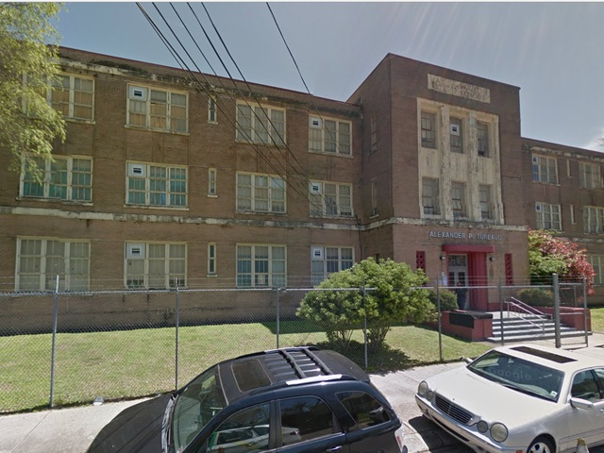
Which Schools?
Valena C. Jones School in the 7th ward - corner of London Ave and North Miro Street 1901 N. Galvez St.
Israel - Augustine School - 425 S Broad St.
A.P. Turead School near St. Bernard Avenue - 1715 St Bernard Avenue, New Orleans, LA
Notes:
https://savingplaces.org/stories/new-orleans-israel-augustine-meyer-middle-school-waits-to-be-saved
The building’s Spanish Colonial Revival entryway welcomed students until 2005, when the structure was severely damaged by Hurricane Katrina. It was stabilized and mothballed using FEMA funds, and a 2017 assessment appraised the structure’s value at approximately $5.4 million. Despite the storm and the humid climate, the WPA murals are in good condition. The school is currently threatened by neglect, and its unaddressed mildew and rot from water damage and structural issues continue to worsen. The Louisiana Landmarks Society placed the school on its 2017 New Orleans’ Nine list of endangered sites.
https://midcitymessenger.com/2014/06/05/former-augustine-middle-school-building-up-for-sale-for-charter-organizations/
According to Le, renovations for the Augustine building would be a “humongous challenge.”
“That would be one of the most major capital investments we’ve ever made,” Le said. “I would have to get an architecture survey or report on the structure of it. We’d have to do all of the wiring and the flooring. And there’s numerous places where we’d have to do termite treatment.”
Moreover, she added, the foundation seems to be sinking.
Because the building is also in a historic district, Le said it could run anywhere from $7-10 million “easily” to do those kinds of renovations. And that means that the school has to be realistic about renovating buildings like Augustine, she added.
“Depending on how much it costs, it might be cost-prohibitive for us,” Le said. “We don’t have unlimited funding.”
Augustine one of many buildings on surplus list
https://thelensnola.org/2011/02/09/abandonedschools/
Under the latest facilities master plan, Jones is slated for restoration during the third phase of school construction, but there is no start date for that phase. Green said the soon-to-be-adopted final master plan could change the phasing sequence of school construction in stride with the GCR demographic study. “Which schools are being built will change,” Green said. “We have to put the schools where the kids are.” The comment does not bode well for Jones, which was built when the 7th Ward boasted a significantly larger population and stands within a mile of three other shuttered campuses. The demographic study projects anywhere from 10 percent to 20 percent student population growth for the 7th Ward, putting the neighborhood in the same slow-recovery category as Broadmoor, St. Roch and parts of eastern New Orleans. Neighborhoods where population growth has been steadier since Katrina or public housing redevelopments have been torn down to make way for mixed-income redevelopments could see student population grow by up to 30 percent, the GCR study said.

Slide 17
Stakeholder-Supported Proposal to OPSB
“...Our education spending has been frozen for most of the past decade.”
- United Teachers of New Orleans ²
Productivity & Aesthetic
New Orleans has a C-letter grade for its education system.¹
“A lot of these properties are not located in areas that would lend themselves to a lease. It would be more advantageous to sell them to people and use them how they deem fit."
“Regardless if the sites are sold, or leased, the owner at Coffee Science just wants action for the neighborhood eyesore.”
- Local Business Owner ³
"We have a shrinking population and school population. Those buildings need to get put back into use…I think the best thing is to sell.”
- Woody Koppel, former Orleans Parish School Board (OPSB) member ³
Maintenance of unused schools costs the education system $500,000 annually. ³
If the Office of Homeless Services and Strategy purchased schools, it would put money towards education!
1. NOLA Public Schools District Performance Score Shows Improvement. (n.d.). NOLA Public Schools. https://nolapublicschools.com/news-blog/nola-public-schools-district-performance-score-shows-improvement-1#:~:text=The%20district%20improved%20its%20overall
2.Why is Louisiana ranked so low in education? | United Teachers of New Orleans. (2018, January 31). Utno.la.aft.org. https://utno.la.aft.org/news/why-louisiana-ranked-so-low-education
3. Mackel, T. (2023, May 16). Abandoned, dilapidated: NOLA Public Schools has 30 unused properties. WDSU. https://www.wdsu.com/article/louisiana-nola-public-schools-unsused-property/43772441
Notes:
There is precedent for government job training programs, which supports our solution for career coordinators.
The National Coalition for the Homeless detailed a 1988 program by the US Department of Labor. Department of Labor created the Job Training for the Homeless Demonstration Program which funded job training activities.
The USDL funding was discontinued in 1995, but Congress expressed that it expects the US Department of Labor to use the expertise gained from the program to enhance the capacity of national employment programs to serve people facing homelessness.
Furthermore, a study highlighted by the NIH on the impact of coaching in sustaining employment among people facing homelessness found that those with coaching had a 3.75x increase in integration into the labor market compared to those who did not.
We know that employment coaching is effective. Our goal with the NOLA career coordinators is to have a knowledgeable mentor find employment opportunities that are suitable for each individual’s skills and ability. This would reduce friction in the job search process

Slide 18
Structured Housing System
SRO = SINGLE ROOM OCCUPANCY
Tier 3 - In Unit (SRO)
Tier 2 - In Unit (SRO)
Tier 1 - Established NOLA Shelters
20% of all residents
Has an affordable monthly fee ($650 per month)
Apartment-style housing
Must have proof that they have been working for over 10 days or on SSDI
50 spots reserved for people on SSI or with disabilities not able to obtain SSDI/SSI or a career (signed off by career coordinator)
40% of all residents
Unit-style housing
Requires a subsidized fee ($300 adjusted per month)
Avg. 100 day stay
Must prove that they are on the track for job training or skills OR on SSDI/SSI
50 spots reserved for people with disabilities not able to obtain SSDI/SSI or a career (signed off by career coordinator)
40% of all residents
Shelter-style housing
Requires no cost to stay in
Avg. 30-90 day stay
Notes:
Our structured housing system follows three tiers. The first tier does not require new housing built, as it functions through the already existing NOLA shelters.
The second tier requires proof of being on track for job training, proof of SSDI/SSI, or debilitating disability, signed off by a career coordinator. The third tier requires proof of being employed for at least 10 days, SSDI, or SSI and/or debilitating disability, signed off by a career coordinator.
Tier 2 and Tier 3 will be in the same buildings; the rent just differs. Tier 2 can be classified as transitional housing, and tier 3 is semi-permanent housing with the goal of exiting the system when they feel ready to.
If loss of job occurs in Tier 3, then refer to one-month plan located in Appendix.
To manage overflow, people facing homelessness must be approved to enter Tier 2 or Tier 3 by a career coordinator or a coordinated entry system manager. Households that are not homeless but are burdened would be assisted by coordinated entry system managers to find rental assistance options. We would need to expand this initiative in order to accommodate them, but for now, we are focusing on the already-homeless population.

Slide 19

Private Housing Arrangements
Each of these schools would be able to house 140-160 people at any given time.
People are separate into two groups within each school: Tier 2 and Tier 3.
Tier 3
Tier 2
Notes:
Each of these schools would house 140-160 people. Within each school, we will separate the school into Tier 2 and Tier 3 sections.

Slide 20
Within each school, there is…
A Supervisor
Regular Maintenance
In-Shelter Job Opportunities
Supervises daily needs, refers residents to community resources, holds community events, organizes transportation assistance to jobs/stores, etc.
Outsource work to NOLA Habitat for Humanity’s Maintenance Repair.
Government-funded career coordinators will connect residents to in-shelter jobs.
Food Sources
Furnished Rooms
A Laundry Room
Partnership with multiple local food pantries to have supplemental nutrition for those who need it. Unit-style will have microwave and mini-fridge. Apartment-style will have microwave, fridge, stove, and oven.
Partnership with manufacturers to buy furniture in-bulk (chairs, tables, beds, desks, couch.)
Equipped with 10 washers and 10 dryers for all residents to use.
This approach is scalable, as if it works in one school it will work in all 25. Expansion to old warehouses, churches, and storage units can also be considered in the future.
Notes:
Within each school, we will have a supervisor to address daily needs, refer residents to community resources - but note, at this time they have received technical and supportive resources from career coordinators and CES so supportive services should be partially established -, holds community events, and organizes transportation assistance for residents. The school will also include regular maintenance, in-shelter job opportunities - clients are connected through career coordinators, a laundry room, supplemental nutrition, and furnished rooms.
An important distinction to note here is that Tier 2 is Unit-Style while Tier 3 is apartment style. This distinction is made with the budget in mind and to be able to offer subsidized pricing this approach will be key. Differences to note are that Tier 2 will have beds, a small table and a “kitchen-area” with a hot plate and microwave. Tier 3 will be furnished with a basic kitchen and bedroom package.
Notes:
To equip both Tier 2 and Tier 3, we want to work on establishing partnerships with local furniture and houseware manufacturers. Our objective is to secure arrangements that allow us to furnish our units at reduced costs, driven by two primary reasons. Firstly, we aim to position our sale as a philanthropic cause. We hope to appeal to local manufacturers who may have connections to NOLA and a genuine desire to uplift the community. This not only represents an opportunity for them to contribute positively they can also use it as a tax write off. Secondly, our strategy involves the initial bulk purchase of furnishings for five of these renovated school buildings. The advantage of bulk buying lies in our ability to negotiate more favorable pricing terms, ultimately ensuring cost-efficiency in the revitalization of these educational spaces. Secondly, our strategy involves the bulk purchase of furnishings for five of these renovated school buildings. The advantage of bulk buying is our ability to negotiate more favorable pricing terms, ultimately having the potential to make this more cost-efficient.

Slide 21

Monthly Open Committee
Spearheaded by Local New Orleans Government
Promotes transparency, increasing trust and feedback
Committee will start January 2024 and continue until further notice
Committee will present on progress of construction and when construction is finished, status of housing system
Notes:
The open committee would be our system for providing transparency, increasing trust amongst the community, and receiving continuous feedback. The committee will include Office of Homeless Services & Strategy staff members, developers, and partners, and the committee session would be open to all citizens interested in attending. The session would also be recorded for accessibility.

Slide 22



Benefits
Utilizes established buildings → reuses buildings and reduces need for creating additional space
Clients handle salary and rent and maintain individual housing arrangements → financial autonomy, responsibility, privacy.
In-housing work opportunities → reduces transportation time, creates stigma-free workplaces, and facilitates a circular system for longevity

Slide 23
Confronting Tradeoffs

Slide 24








Confronting Tradeoffs
Database
Private Housing
Employment Assistance
Lack of motivation to utilize database → $500/month incentive & monthly-check-ins
How to find jobs? → community partnerships & partnership with UNITY to assess already established connections
Potential for underuse → track clicks & collect monthly feedback surveys from staff
Concern about Duration → system is designed to allow people time to earn economic stability, which is necessary for leaving if they wish
Potential for administrative burden → collect feedback surveys and adjust time frame if needed for data input
Potential for inefficiency in one-on-one meetings → more intentional meetings will allows clients to find better job fits, increasing employability and job retention
Community stigma of unit → increase volunteer opportunities²
Tech. barrier → advertise database with local library addresses¹
1. Coffee and donuts spark homeless outreach at New Orleans Public Library | Tulane School of Social Work. (n.d.). Tssw.tulane.edu. https://tssw.tulane.edu/news/coffee-and-donuts-spark-new-orleans-homeless-outreach#:~:text=The%20survey%20found%20that%2060
2. “Why Homelessness Is Stigmatized.” Unity Parenting and Counseling, 8 Apr. 2022, unityparenting.org/why-homelessness-is-stigmatized/.
Notes:
For continuous incentive to regularly input data, NOLA will provide $500 per month to shelters registered with the database and perform monthly check-ins to track activity on database and ensure shelters are inputting - specifically bed capacity - regularly.
To ensure database is being accessed by the public, NOLA will track clicks of the database’s link and collect feedback surveys from homeless shelter staff.
When collecting feedback surveys, we can identify if hourly updating is a burden and adjust the time frame in which updates must be uploaded to ensure a balance between burden on staff and useful, updated information for the community. We would like to note that all shelters do have a counting mechanism already in place because accepting too many clients is disastrous.
To provide accessibility for people without technology, advertising of database will mention addresses to local libraries where people may use computers to check database.
To find jobs for clients, career coordinators would create community partnerships between certain employers, in various industries (food service, administrative duties, etc.) Career coordinators could partner with UNITY to assess already established community connections. By creating these partnerships, career coordinators could reduce bias and stigma surrounding employment of people facing homelessness.
Personalized approaches are more efficient in the long run than simply delivering a catalog of job opportunities. By having more intentional meetings, clients will ideally be placed in a job that is a better fit for their individual skill set and abilities.
In regards to people potentially having difficulty exiting our system, we would like to remind that the purpose of our system is to help people get back onto their feet and have enough economic stability to afford regular housing. To combat homelessness, we want to provide all residents with ample resources and support which is necessary before they may think about financial independence.
To reduce² stigma surrounding homelessness, we would encourage volunteer opportunities at the community events supervisors organize such as barbeques, picnics, etc..
For incarcerated or other vulnerable populations, view the appendix to see resources that unit supervisors, CCs, or CESs can refer clients to.

Slide 25
Logistics and
Metrics of Evaluation

Slide 26
General Project Timeline, 2024
Renovate 3 school buildings with Greater New Orleans Housing Alliance. Monthly open committees held. Career coordinators may refer people from shelters to construction jobs.
Settle career coordinators in shelters
Hold monthly meetings amongst all career coordinators
Hire 13 career coordinators
Train career coordinators
Distribute monthly incentives, perform monthly check-ins & tracking, and collect monthly feedback surveys
Create database
Register homeless shelters on database
Run database on websites
Raise awareness of database to public
Jan. 2024 June 2024 Dec. 2024
Homeless Shelter Availability Database
Employment Assistance
Private Housing Arrangements
Notes:
A more detailed, per-solution specific timeline is available in the Appendix.
First third of year: Create database, hire 13 career coordinators
Second half of year: Publicize database, settle career coordinators in shelter
Third half of year: Collect surveys and distribute incentive for database usage, hold monthly meetings amongst all CCs
We would renovate school buildings throughout the year and hold monthly open committee meetings.

Slide 27
General Project Timeline, 2025
General Project Timeline, 202
Hold monthly open committees.
Hold monthly meetings amongst all career coordinators
Distribute monthly incentives, perform monthly check-ins & tracking, and collect monthly feedback surveys
Renovate 5 school buildings with Greater New Orleans Housing Alliance. Career coordinators may refer people from shelters to construction jobs. Hire 3 supervisors and train them.
Establish partnerships and finish furnishings.
Place individuals.
Jan. 2025 June 2025
Homeless Shelter Availability Database
Employment Assistance
Private Housing Arrangements
Notes:
A more detailed, per-solution specific timeline is available in the Appendix.
In 2025, we will finish up renovation of school buildings, hire supervisors, establish resource partnerships and finish furnishings, and then place individuals.

Slide 28
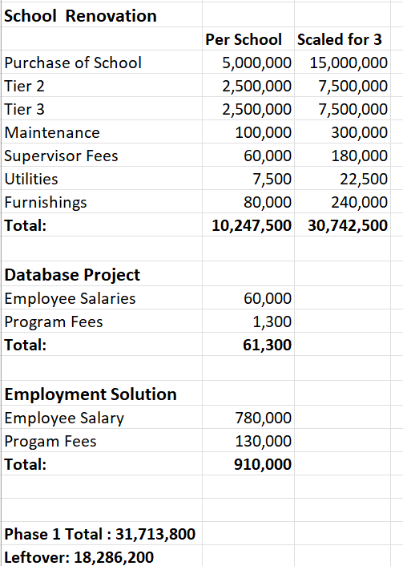
Budget
Notes:
Our hope is to generate enough revenue from both Tier 2 subsidized rent and Tier 3 rent to fulfill all the expenses associated from running a unit. However, we understand that this is a variable long-term and with the projected budget we should have enough left over from the overall $50,000,000 ( we are left with 22,791,200 ) budget in order to keep this program running.

Slide 29
Sources of Funding
2. Remainder of $8M Trust Fund ²
New Orleans had a trust fund established for developing affordable housing that was terminated because voters felt there was a lack of transparency or vision for spending the funds
Continuum of Care Fund ¹
Continuum of Care Louisiana is the largest funding source for housing and services in the LA Balance of State Continuum of Care (BOSCOC)
Office of Homeless Services and Strategy would apply to fund permanent housing (Tier 3)
3. HUD Louisiana Fund ³
The HUD ( Housing and Urban Development ) Fund is considered one of the City’s major funds. The FY2023 adopted budget includes revenues of $81,199,478 in the HUD Fund
Restructure the Fund:
↓ 2023 Health & Safety Owner Occupied Program
↓ Affordable Rental Housing Gap
1. Continuum of Care Program Funding. (n.d.). Louisiana Balance of State Continuum of Care. Retrieved October 28, 2023, from https://laboscoc.org/coc-program-funding
‌2. TUPHCC ase Competition Details, 2023
3. 2023 Annual Operating Budget. 2023. https://nola.gov/nola/media/Mayor-s-Office/Budget/2023/2023-Budget-Book-City-of-New-Orleans-Compiled-Budget-Book.pdf
Notes:
The LA BOSCOC applies for CoC Program funding every year.
It submits one large application to HUD (the consolidated application) for its entire geography. The consolidated application includes both information about the LA BOSCOC and individual project applications that fund housing and supportive services.
It would take an internal look into the program success rates, budgets, and diffusion rates in order to make an informed decision on where we reallocate funds, but we would go down this hierarchy of solutions.
This fund had about $8 million dollars allocated towards it originally, though some was used during COVID-19. We believe that with our structured solution and program transparency we can regain these funds to allocate them towards our solution.
LA BOSCOC: LA Balance of State Continuum of Care

Slide 30
Criteria
13 Units Finished
50% Reduction
90% Satisfaction
Scalability
Effectiveness
Acceptability
After the first 3 Units are implemented, we hope to see success rates high enough to scale this project over 13 schools.
We hope to see a 50% reduction in the homeless population by 2030 on the streets or shelters
Through resident and employee surveys, we aim to have a 90% satisfaction rate with program operations.

Slide 31
Feedback Loop
To ensure transparency, the City of New Orleans local government can host recurring public forums to provide affordable housing updates and address questions and concerns
Office of Homeless Services and Strategy will track views/clicks on database, survey effectiveness of data inputting among shelter workers
Greater New Orleans Housing Alliance & HousingNOLA can collaborate to renovate public schools into rent-subsidized transitional for employed and/or severely disabled individuals
Career coordinators will collate a list of job opportunities that is tailored towards a range of abilities and skills.
Notes:
Each of our solutions will tie into the next. Getting more people into the shelter means more of a demand for career coordinators. The more resources and employment opportunities that career coordinators are able to connect people facing homelessness to, the more likely they to be able to afford transitional housing and more permanent housing, to eventually move out of the system. To ensure that our system is functioning properly, the City of New Orleans can host public forums and update interested community members and stakeholders, and hear their concerns and suggestions.

Slide 32
Summary
Homeless Shelter Availability Database
Accessibility
Employment Assistance through Career Coordinators
With consistent evaluation of effectiveness, these solutions will decrease homelessness in New Orleans.
How can we address the New Orleans Homelessness Crisis?
Autonomy
Private Housing Arrangements
Privacy

Slide 33
Appendix
Per-Solution Timelines
Supporting Vulnerable Populations
Alternative Schools for Housing Conversion
Tier 3: Loss of Job Plan
Why Career Coordinators
2022 Annual Operating Budget of New Orleans

Slide 34
Database Timeline
*All tasks are the responsibility of the Office of Homeless Services & Strategy
January 2024 - February 2024 - Create database
  Insource work to Richard Couget, the current administrator of the Office of Community Development’s “Homeless Service Providers” site
  Create informational pamphlets to explain data input procedure
February 2024 - April 2024 - Perform outreach to homeless shelters in NOLA to register on database
  Conduct trainings for usage of database and distribute informational pamphlets
April 2024 - May 2024 - Database starts running on established websites
May 2024 - July 2024 - Perform outreach to the public to raise awareness of database tool:
  Billboards
  Bus stops
  Fliers/posters
  Communication with jails and hospital ERs
  Libraries
Notes:
https://us05web.zoom.us/j/3347422047?pwd=aUV0SGZnRWFlQzl0Nitram5EeFVUdz09

Slide 35
Employment Assistance Timeline
January 2024 - February 2024 - Hire 13 career coordinators
  May be Certified Career Counselors or graduates of Bachelor’s of behavioral, social science, or human services field.
February 2024 - April 2024 - train hired personnel on tasks expected (including usage of running catalog of careers), SSI/SSDI, and of the population whose needs must be met
April 2024 - May 2024 - settle hired personnel in respective shelters
*Personnel will have monthly meetings with other personnel to raise issues, collaborate to find solutions, and improve the employment assistance process across the city as a result

Slide 36
Private Housing Arrangements Timeline
January 2024 - March 2025- Renovations completed
  Renovations completed by Greater New Orleans Housing Alliance & HousingNOLA
May 2024 - December 2024 - clients from homeless shelters may be referred by career coordinators to take construction job with project
January 2025 - March 2025 - Hire 5 supervisors for each school and train them on the structured housing system and how to meet the needs of residents through referrals and outreach.
March 2025 - May 2025 - establish partnerships and finish furnishings
  Establish partnership with NOLA Habitat for Humanity’s Maintenance Repair
  Fill all jobs at private housing arrangements with assistance of career coordinators or other external hiring formats
  Place and test all washers and dryers in laundry room
  Establish partnerships with local food shelters
  Partner with manufacturers to furnish all rooms with chairs, tables, beds, desks, and couch
    Unit-style will additionally have microwave and mini-fridge
    Apartment-style will have microwave, fridge, stove, and oven
May 2025 - June 2025 - begin placing individuals based on career coordinators’ evaluations

Slide 37
Supporting Vulnerable Populations
CC, CES, and Tier 2 & 3 Supervisors may facilitate clients’ communication with:
Incarceration
Hope House NOLA: provides housing, mentorship, and guidance for formerly incarcerated and impacted women and girls
Cornerstone Builders: works with individuals and families impacted by incarceration and reduces reoffense rates amongst at-risk individuals
Substance Use
Bridge House/Grace House: offers 24/7 residential rehab facilities
Crescent Care: outpatient services and MAT
Mental Health
NAMI New Orleans: offers outpatient services and counseling
University of Holy Cross Counseling Program: low-cost, remote counseling program

Slide 38
Alternative Schools for Housing Conversion
Moton School in Desire - 3048 Abundance St.
Pauger St.
Booker T. Washington High School - 1201 S. Roman St.
Morris FX Jeff School - 800 N. Rendon St.
LaSalle Elementary School - 6048 Perrier St.
Hansberry ES, 1339 Clouet St.
Armstrong ES, 5909 St. Claude Ave.
Mondy ES, 2327 St. Philip St.
Priestley Jr. HS, 1619 Leonidas St.
Audubon Ext. (Carrollton Courthouse), 719 So. Carrollton Ave.
Notes:
https://thelensnola.org/2011/02/09/abandonedschools/
Like Valena C. Jones, Booker T. Washington has become a popular spot for vandals, thieves and squatters. Dating to the 1940s, the Art Deco school was the first new high school in New Orleans built specifically for African-American students. That history has been slowly stripped in the five years since Katrina, thieves having removed architectural detailing and tens of thousands of dollars worth of copper. With better maintenance and security from looters, preservationists contend that the historic school could have been restored for less than it would cost to replace it. “It is a concrete-framed building with a brick exterior, and I think everyone involved agrees that it’s feasible to bring it back online,” National Trust for Historic Preservation fellow Brad Vogel said. “But now it is a matter of cost. It will cost more to save it.” The current plan calls for all but the school’s auditorium to be torn down this year. The old auditorium will be incorporated into the new building.
Morris FX Jeff School
While eager to see the building auctioned for redevelopment, neighbors say that years of neglect by school officials could make it a tough sell.
“It’s a beautiful historic building, but every month that passes, it deteriorates and loses value,”said neighbor Brod Bagert Jr., a member of the board of Morris Jeff Community School, a charter school that is located at the old Welcome School at 2239 Poydras St., but initially formed with the intention of taking over the Morris FX Jeff site and would still happily claim the site if the RSD would agree to keep it in its school portfolio.
LaSalle Elementary School
This 1900-era Italianate-style building on the corner of Webster and Perrier streets in the Uptown Historic District has been vacant since 2000 when NOCCA moved to a new campus on the downtown riverfront. The Orleans Parish School Board has wanted to auction the building for years but has yet to sell it. In January, district councilwoman Stacy Head passed a resolution calling on OPSB to secure such abandoned properties and using the Perrier Street building as a poster child for school board-owned blight.

Slide 39
Tier 3: Loss of Job Plan
If an individual loses their job in Tier 3, they will enter a 1.5-month grace period where they will:
  Week 1: Meet with Career Coordinator to develop a plan to apply for a job or enter a job training program
  Week 2: Apply for Jobs/Job Training Programs
  Week 3: Apply for Jobs/Job Training Programs
  Week 4: Apply for Jobs/Job Training Programs
  Week 5: Apply for Jobs/Job Training Programs
  Week 6: Accept position into job/job training program
*If they work for the shelter during this time, their grace period is infinite for if they would like to find an outside career
If an individual loses their job due to physical or mental health:
  They will either be able to apply for disability alongside a Career Coordinator or be eligible for one of the 100 spots reserved across the unit for unable-to-work populations

Slide 40

Why Career Coordinators?
“Personal approaches and individual coaching seem to be promising strategies in social work practice and specifically in return to work programs for people who have experienced homelessness.” ³
3.75x
1988: The U.S. Department of Labor ¹ created the Job Training for the Homeless Demonstration Program (JTHDP) to provide funds for basic skills and literacy instruction, job training, referral, and job search activities for the homeless.
The chance of integration in the labor market is
Higher among those who were supported by a job coach as compared to those who were not supported by a job coach. ³
Conclusion: Successful employment programs must specifically target their outreach and enrollment efforts to homeless individuals to overcome obstacles to employment. ²
Hire social workers or human resource specialists through the Office of Homeless Services and Strategy.
1. National Coalition for the Homeless. (n.d.). Www.nationalhomeless.org. Retrieved October 22, 2023, from https://www.nationalhomeless.org/publications/facts/employment.html#:~:text=While%20employment%20and%20training%20programs
2. Job Training for the Homeless Demonstration Program: U.S. Department of Labor--Employment and Training Administration. Final Evaluation Report. (1992). ERIC. https://eric.ed.gov/?id=ED355984
3. Hoven, H., Ford, R., Willmot, A., Hagan, S., & Siegrist, J. (2016). Job Coaching and Success in Gaining and Sustaining Employment Among Homeless People. Research on Social Work Practice, 26(6), 668–674. https://doi.org/10.1177/1049731514562285
Notes:
There is precedent for government job training programs, which supports our solution for career coordinators.
The National Coalition for the Homeless detailed a 1988 program by the US Department of Labor. Department of Labor created the Job Training for the Homeless Demonstration Program which funded job training activities.
The USDL funding was discontinued in 1995, but Congress expressed that it expects the US Department of Labor to use the expertise gained from the program to enhance the capacity of national employment programs to serve people facing homelessness.
Furthermore, a study highlighted by the NIH on the impact of coaching in sustaining employment among people facing homelessness found that those with coaching had a 3.75x increase in integration into the labor market compared to those who did not.
We know that employment coaching is effective. Our goal with the NOLA career coordinators is to have a knowledgeable mentor find employment opportunities that are suitable for each individual’s skills and ability. This would reduce friction in the job search process

Slide 41
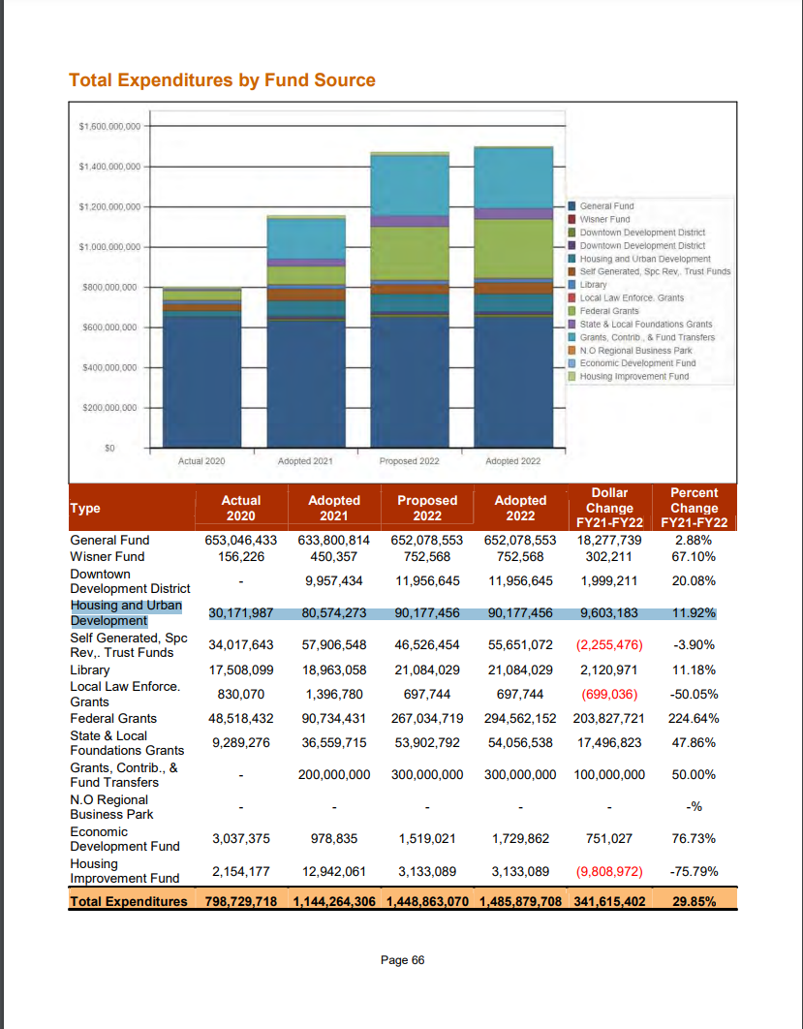
HUD Funding
in 2022 Annual Operating Budget of the City of New Orleans
≈ $90M

Slide 42

Notes:
We acquired this slide deck template from SlidesGo, and we are required to keep the attribution slide in the presentation.

