Slide 1

Applied Practice Experience Orientation
School of public health and tropical medicine

Slide 2

APE at a Glance
What is the APE/Practicum?
How do you find an APE?
What do you need to apply?
How do you apply?
What is required to complete the APE?
Faculty and Staff Q&A Panel
Notes:
Susan

Slide 3
What is the practicum (APE)?
A public health practicum is the opportunity to apply your classroom experience in a work setting.
It is required for all students in professional master’s programs (MPH, MSPH, MPH&TM), including those with prior work experience.
The practicum may be done in a variety of settings outside of the university, and it may align with future career goals.
Notes:
Susan

Slide 4
Purpose of the practicum
The practicum (APE) needs to apply public health practice in the field
Should demonstrate competencies of a practice degree
There should be a clear audience or stakeholder group that benefits from the work
Supervised and evaluated by preceptor and advisor
Practicum Handbook: https://inside.sph.tulane.edu/student/practicum_forms
Notes:
Susan

Slide 5
practicum Site
Student
Tulane Faculty Advisor
Preceptor
Student responsibilities:
Identify a practicum site and preceptor
Develop a practicum proposal
Develop proposal for at least 2 work products
Complete at least 120 hours & submit timesheets
Complete and submit final report, PowerPoint, work products
Evaluation of preceptor

Slide 6
practicum Site
Student
Tulane Faculty Advisor
Preceptor
Preceptor responsibilities:
Guide development of APE/practicum plan and proposed work products
Review and approve APE/practicum proposal
Guide development of work products and practicum activities
Review and approve work products and final report (including timesheets detailing hours)
Evaluation of Student

Slide 7
practicum Site
Student
Tulane Faculty Advisor
Preceptor
Faculty responsibilities:
Review and approve APE/practicum plan
Review and approve timesheets (every 40 hours)
Review and provide feedback on final report and PowerPoint
Review and provide feedback on work products
Review and approve completion of APE and demonstrated competencies through submission of work products

Slide 8
Sphl 9980 ape Process map
Application
Identify APE site, preceptor, project
Canvas
Student uploads documents:
Completion
Faculty Instructor in Canvas grades (P/F):
Signed by
Register for SPHL 9980
Affiliation Agreements as needed
Student resume
Student transcript
Preceptor resume
APE signed proposal
Final report
2(+) work products
Evaluations
Preceptor
Student
Final Report
2(+) work products
Reviews preceptor evaluation for average(+) rating
Completes paperwork for Public Health Practice and Academic Affairs
Paperwork is submitted to Academic Affairs
1. student
2. preceptor
3. faculty advisor
Complete Proposal using Template

Slide 9
What is a practice setting for ape?
Domestic and International Practice Settings:
governmental
non-governmental
non-profit
industrial
for-profit setting
wellness centers in higher education
or many other practice settings not on this list (with approval by faculty advisor)
Notes:
Susan

Slide 10
application
practicum Plan & Timeline
CEPH Competencies Demonstrated
Student Resume
Unofficial Transcript
Goals/ Objectives
Preceptor CV/Resume
At least 2 Work Products
Required of every MPH and DrPH Student

Slide 11
What are Work products?
project plans
grant proposals
training manuals or lesson plans
surveys
memos
Videos
*Reflection papers, contact hour logs, scholarly papers prepared to allow faculty to assess the experience, poster presentations, and other documents required for academic purposes may not be counted toward the minimum of two work products.
podcasts
presentations
spreadsheets
websites
photos (with accompanying explanatory text)
other digital artifacts of learning

Slide 12
COMPETENCIES
Practicum should list 3-5 competencies that are demonstrated by work products and practicum activities
At least 3 foundational competencies
Foundational Competencies: https://sph.tulane.edu/foundational-curriculum
At least 2 concentration competencies
Program Competencies: https://catalog.tulane.edu/public-health-tropical-medicine/
Notes:
Susan

Slide 13
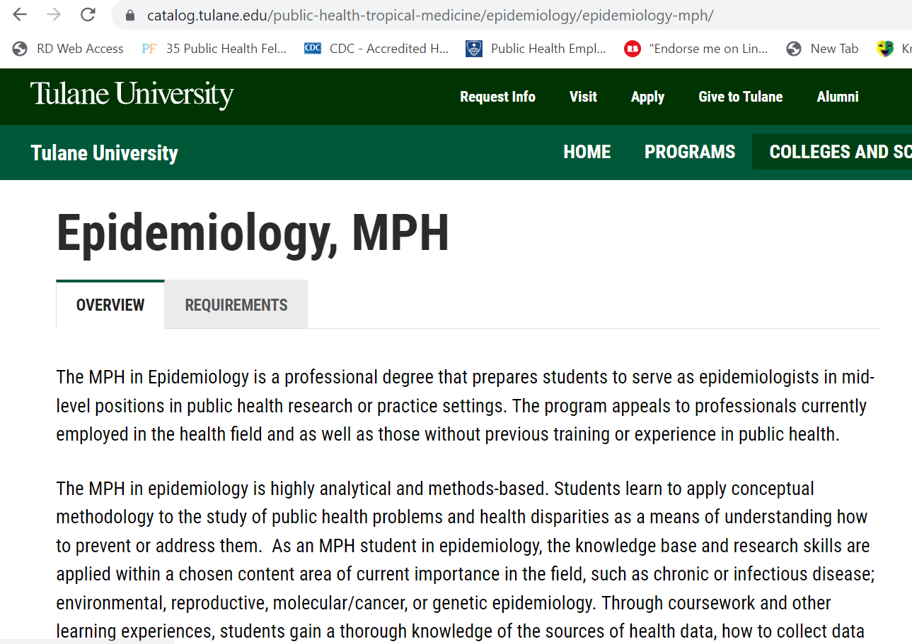
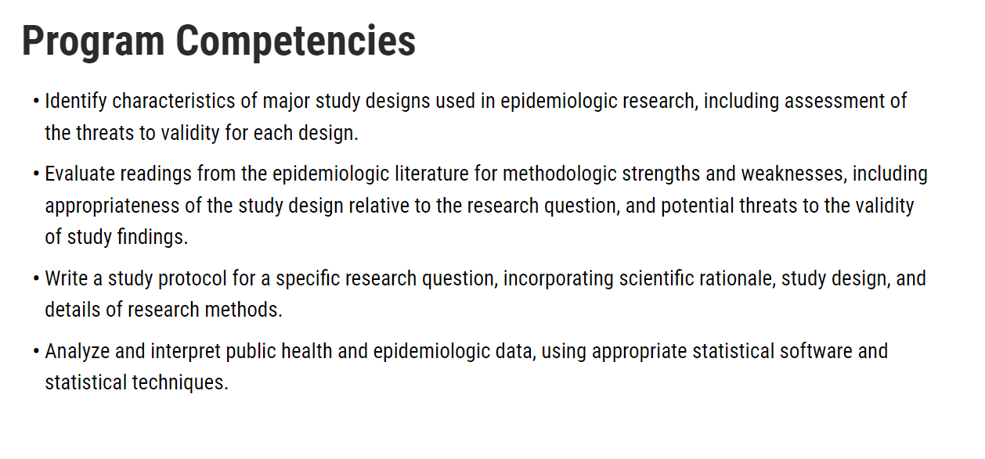
competencies
Notes:
Susan

Slide 14
Required documents
Final Report
Work Products (at least 2)
Evaluations (student and preceptor)
Timesheets Documenting Completed Hours
Notes:
Isa

Slide 15
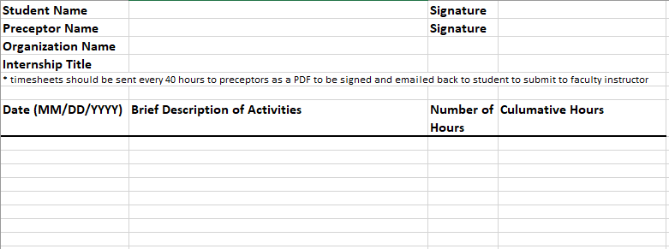
timesheets
Notes:
Isa

Slide 16
Final report
Discussion of highlights, challenges, responses
Description of work products (at least 2)
Discussion of how work products met competencies
Self-assessment of career development
Evaluation overall practicum and preceptor experience
Summary of activities of practicum
Notes:
Isa

Slide 17
WORK PRODUCTS
Should demonstrate >5 competencies
3 Foundational competencies
2 Concentration competencies
At Least 2 Work Products*
*May change from practicum proposal by joint approval of faculty and preceptor
Notes:
Isa

Slide 18
Examples of Work Products
spreadsheets
websites
photos (with accompanying explanatory text)
other digital artifacts of learning
*Reflection papers, contact hour logs, scholarly papers prepared to allow faculty to assess the experience, poster presentations, and other documents required for academic purposes may not be counted toward the minimum of two work products.
project plans
grant proposals
training manuals or lesson plans
surveys
memos
Videos
podcasts
presentations

Slide 19
Preceptor & Student Evaluations
Preceptor Evaluation of Student
Student Evaluation of Preceptor

Slide 20
Tulane-related travel and international practicums or fellowships
Richard A. Oberhelman, MD
Associate Dean for Global Health
Margaret W. and Eamon M. Kelly Distinguished Chair
in International Development
Professor, Dept. of Tropical Medicine
Tulane School of Public Health and Tropical Medicine

Slide 21
OISS Updates for APE
For compliance with DHS, APE or practicum is considered “work” whether it’s paid or not; any student on F1 or J1 visa needs:
Complete CPT
I-20 paperwork
*Prior* to starting practicum

Slide 22
Timeline for f1 and j1 students
Step 1
Step 2
Step 3
Step 4
Step 5
Identify a practicum site, preceptor, and project
Develop APE proposal with faculty advisor and preceptor; obtain approval and signatures
Register for SPHL 9980
Contact OISS to complete CPT and receive I-20
Submit completed proposal forms with all signatures (including OISS check-off)
*start practicum*

Slide 23
Notes from oiss
Students need to be registered for SPHL 9980 and have signed/approved proposal from faculty advisor and preceptor before OISS gets involved
Students who start APE (practicum) before they receive CPT and I-20 from OISS may be immediately deported by DHS and may not return to the US
OISS will take care of CPT and I-20 for students
F1 students have a different proposal form that includes OISS signature and check off
J1 students will have new process to be rolled out Fall 2023
*curricular practical training (CPT)

Slide 24
Tulane-related travel and international practicums or fellowships
All Tulane-related international travel must comply with current university travel policies. Students traveling abroad for academic activities, research, or any other reason related to their affiliation with Tulane University fall under this requirement.
University policy requires that all employees, students, and affiliates engaged in approved Tulane-related activity abroad (1) centrally purchase their tickets—through either World Travel Service (WTS) or Concur, and (2) register their trip for travel tracking and availability of emergency services abroad. This allows the university to track the location of Tulane affiliates abroad, and it automatically enrolls student travelers in Global Rescue in case of emergency. WTS also supports ticketing changes.
Students must be registered in Concur to access Concur or WTS travel services. Students participating in group travel (e.g. overseas courses) will be registered through their faculty program director. For individual international travel activities, students may request travel approval and Concur registration by contacting Dr. Oberhelman (oberhel@tulane.edu) or Robert Palestina (SPHTM global health programs coordinator; rpalesti@tulane.edu). You will need to provide your name, faculty sponsor or advisor’s name, and travel destination. We will provide this information to the Provost’s office on a weekly basis, and we will contact you by email when you are approved to book your travel.
Some destinations may require additional information for approval, depending on the risk level. Students who wish to discuss travel destination safety concerns may contact Robert Palestina to arrange a meeting with Mr. Wade Wootan, Global Affairs & Regulatory Compliance Administrator.

Slide 25
Research and ape
Can research projects be used for an APE?

Slide 26
Purpose of the practicum
Q: can research count as a practicum (APE)?
A: yes, *but* there needs to be an application of the findings or research to practice.
Yes, but, there must be a community or population or practice setting that you are collaborating with, including a preceptor in the field
Yes, but, there must be two work products that benefits the community, population, or practice setting
Yes, but, it cannot count towards future application, it must be used in current practice and demonstrated by production of work products
Yes, but there must be a field experience included with engagement in a community, population, or practice setting.
Notes:
Susan

Slide 27
Examples of research to ape
E.g. Findings are tailored to the needs of an audience through engagement with the community, organization, or population, for a presentation for community education purposes.
E.g. Findings are used as the basis for the development of a policy resolution or proposal, and policy proposal is included as a work product.
E.g. Findings are used to establish new standard of care or standard operating procedures (e.g. for emergency preparedness), and updated SOP is included as a work product.
E.g. Analysis contributes to surveillance measures for local health department or hospital/clinics to help evaluate response.
Notes:
susan

Slide 28
Purpose of the practicum
What is not ok?
Findings contribute to a manuscript submitted for publication without an application to practice.
Or data management/analysis does not contribute to application and is solely for purpose of research.
Or there is no clear application or work product of the practicum/APE.
There should be a community partner or academic partner (e.g. wellness center, health clinic) where application of research is a benefit to the partner organization.
Notes:
Susan

Slide 29

QUESTIONS, COMMENTS, CONCERNS…
Please contact Susan Cheng (wscheng@tulane.edu) or Isabella Parise (iparise@tulane.edu)

